Slide 1
Basic hardwood strength data and grading tools (WP2) Analysis of collected data
Didier Reuling, Guillaume Legrand
FCBA
EU Hardwood meeting June 2016

Slide 2
Collected data Principle

Slide 3
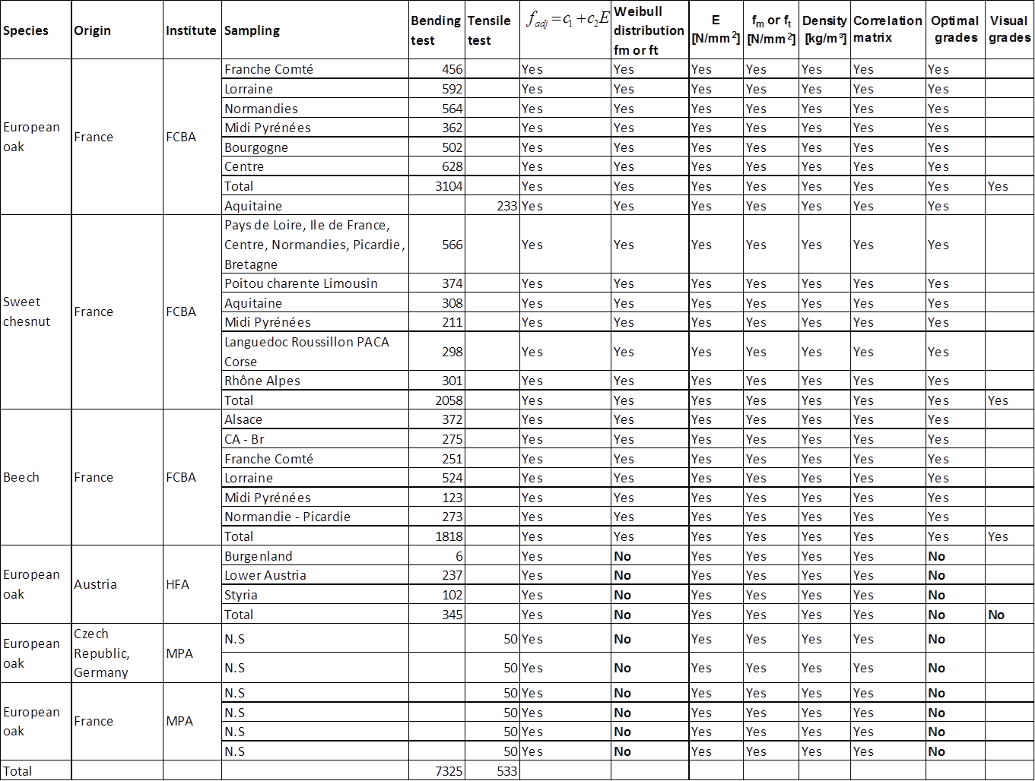
Collected data Results

Slide 4
Collected data Abstract
93 % of the data are bending test
95 % of the data are dedicated to the French resource
92 % of the data are coming from FCBA
Origin of specie | Bending test | Tensile test | Total
Austria | 4% | 0% | 4%
Czech Republic Germany | 0% | 1% | 1%
France | 89% | 6% | 95%
Total | 93% | 7% | 100%
Institute | Bending test | Tensile test | Total
FCBA | 89% | 3% | 92%
HFA | 4% | 0% | 4%
MPA | 0% | 4% | 4%
Total | 93% | 7% | 100%

Slide 5
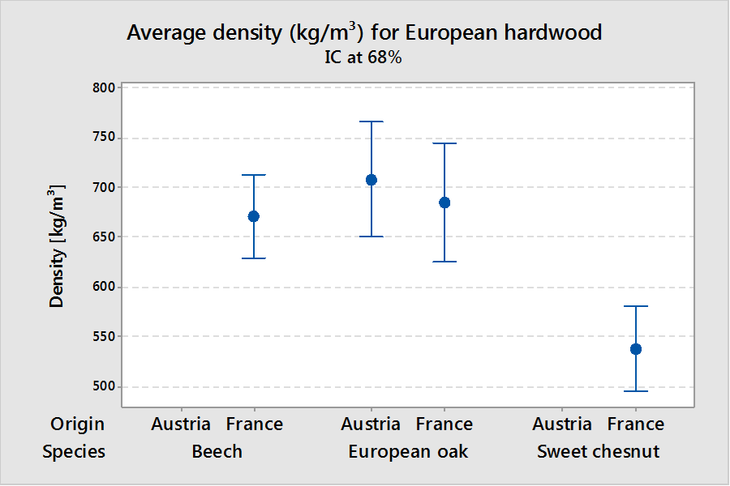
Collected data Analysis

Slide 6
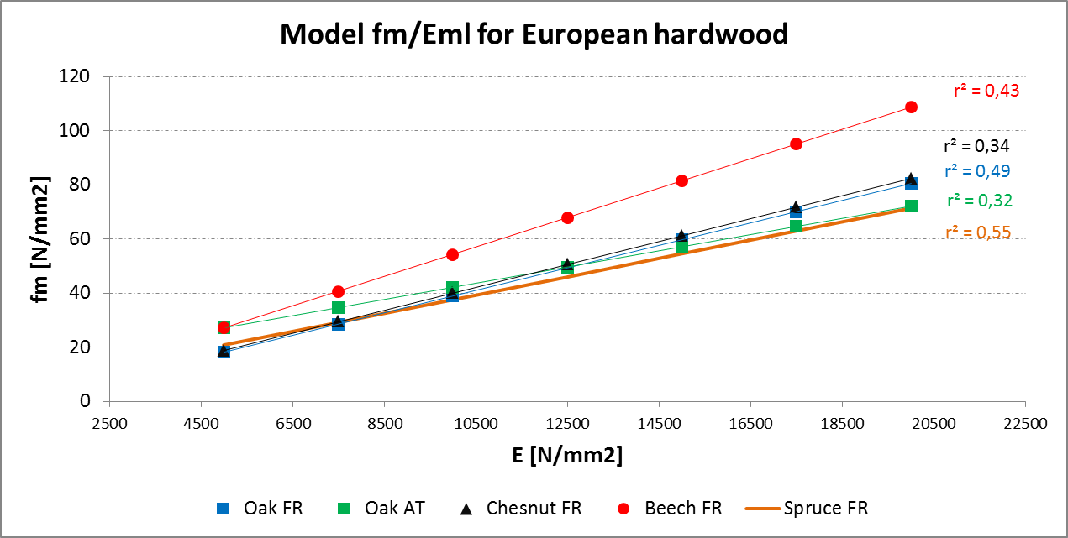
Collected data Analysis

Slide 7
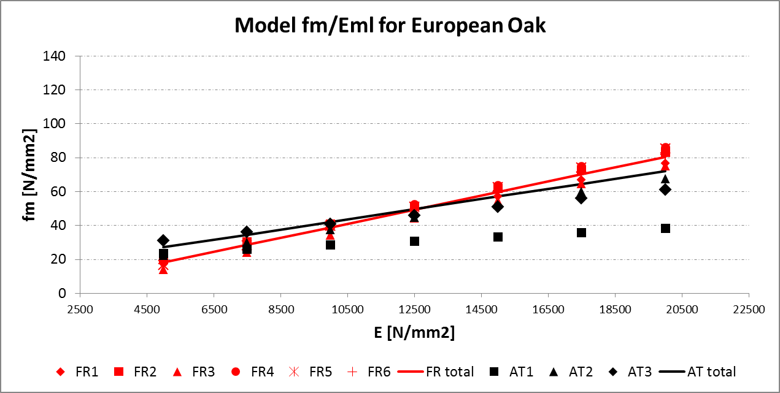
Collected data Analysis
Some troubles with data collection:
Total model of HFA don’t fit with the three sub samples distributions

Slide 8
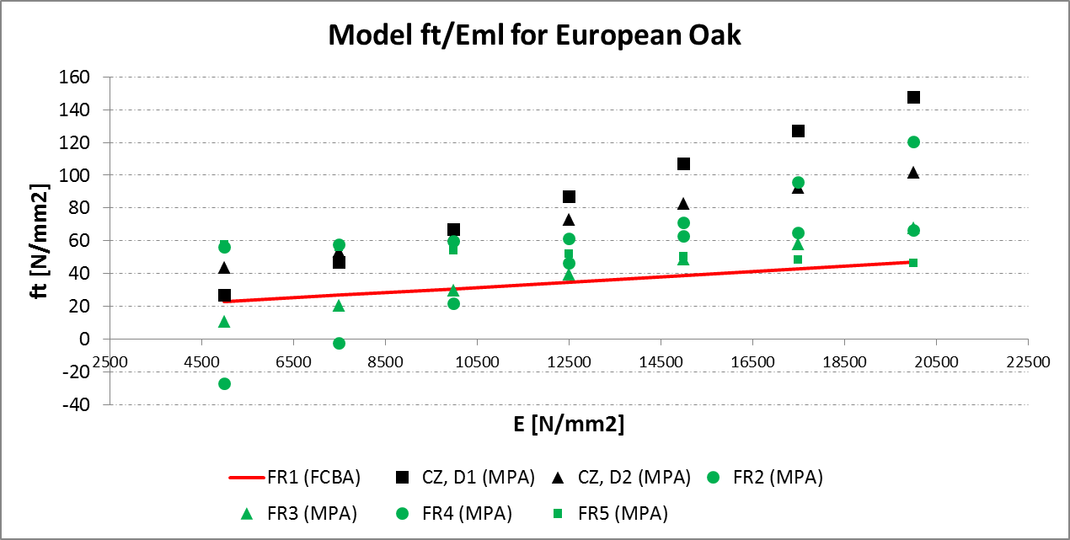
Collected data Analysis
Some troubles with data collection:
Values of ft for oak sent by MPA very high

Slide 9
Collected data Analysis
Proposal for following work in WP2:
Correct and add missing values in the actual data collection
Add some new values coming from other European countries (Switzerland, Italy, Spain, …) not contacted yet
Add some new values coming from tests on going at HFA and Univ Lbj
Comparison of the different hardwood visual grading rules in European countries available with allocation of mechanical properties (HFA)

Slide 10
Still ready to work on new data
Didier Reuling (morgan.vuillermoz@fcba.fr) Guillaume Legrand (guillaume.legrand@fcba.fr)

